Slide 1
Jesus Sends Us the Spirit

Slide 2
The Ascension

Slide 3
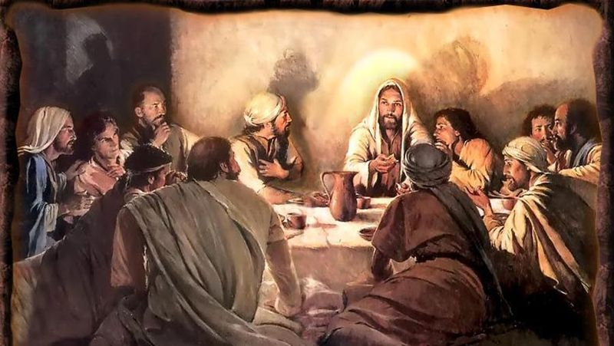
Jesus told the Apostles to “Go and baptize all people in the name of the Father, the Son, and the Holy Spirit.”

Slide 4
The Apostles waiting in the upper room for the Holy Spirit

Slide 5
As Jesus blessed them, he was lifted up into Heaven

Slide 6
Two angels were standing with the Apostles.

Slide 7
The Apostles and Mary waiting for the Holy Spirit

Slide 8
The Holy Spirit

Slide 9
Peter and the Apostles greet the people.

